Slide 1
Surveillance Technology Working Group
Meeting #42 3/21/2023

Slide 2
Agenda
ALPR Public Comment Discussion
Technology Audit Update
School Speed Zones preview
Coming Up
Questions

Slide 3
Reference Slides

Slide 4
Review
Past Decisions
Fotokite: Aerial UAS allowing for different perspectives during crisis response. Not exempt, will go through the process.
Press Release out, done with public comment period
Public comments received, received comments from SPD
Recommendation was sent to the Mayor
Vacant Lot Monitoring: Sensor that detect changes in a scene to monitor lots for dumping. Not exempt, will go through the process.
Press Release out, done with public comment period
Public comments received, waiting for updated data from the requesting department
Community Asset Tracker: Camera with machine learning algorithm to identify objects within the city.
Assessed pilot, documentation provided
COPS: Cameras strategically placed around the city to aid in policing
Exempted

Slide 5
Review
Past Decisions
Samsara: Fleet management technology
Assessed in previous session
Public comment period completed
Recommendation was sent to the Mayor on 2/01
Mayor Walsh stated that he read the read the groups recommendations, and is in agreement with a qualified approval, and is in agreement with the importance of putting in appropriate policies and procedures.
Flock Safety/ALPRs: Street cameras that capture vehicle plates.
Assessed in previous session
Public comment period completed
The Work Group heard from SPD Officers on 1/25/22 for more information regarding this.
The STWG created guidelines for ALPR Use and this was recommended to the mayor with the stipulations written on 3/11/22.

Slide 6
Review
Past Decisions
Cyclomedia: Right of Way Imaging
Public comment period completed
Recommendation was sent to the Mayor on 5/07/22
Mayor Walsh stated: I have reviewed the STWG’s recommendation and I am in agreement with it.
Dataminr: Social Media monitoring of violent posts.
Dataminr staff met with STWG on 6/21/2022.
Dataminr then removed their offer of service on 6/21/2022.
Rubicon: Vehicle route optimization software
STWG met on 9/27/22 and this was determined to not be a form of Surveillance
Opticom: Software that in an event of an emergency the Fire Department could switch the traffic lights on their route to turn green for them.
STWG met on 12/06/22 and this was determined to not be a form of Surveillance

Slide 7
Review
Internal Norms
Attendance:
If members have unjustified absences for three meetings in a three month time period, the Surveillance Team Working Group (STWG) Coordinators will reach out to the member.
The working group is required to have at least 50% of all members present before we hold a recommendation vote.
Of those present at least 40% should be non-city staff.
External Participants:
Outside participants should request permission before-hand to the API team.
The API team will inform the STWG before meetings if there will be outside participants joining the group.
Documentation for Community Review:
The notes from the STWG Sessions will be posted to the STWG Website after the meetings.
Letter of Commitment:
Is effective for one year, and is to be sent out annually.
View Attendance and Guest Norms

Slide 8
Review
Service Level Agreements (SLAs)
2 - 6 Weeks
(10 - 30
Business Days)
Every 2 Weeks
(10 Business Days)
2 Weeks
(10 Business Days)
2 Weeks
(10 Business Days)
Initial submission to determination of surveillance
Short duration meeting to vote on technology exemptions
Public comment period:
Issuance of press release
Council meeting
(*) For now public input will be received via a Google Form and in the future will be on the new website.
Submission of finalized form (by dept.) to time of recommendation.
Group will individually research; departments will get follow-up questions; group to vote yes/no; and submit recommendation.

Slide 9
STWG Long Term Plan (Review)
Update STWG Website
Tech Recommendations
Meeting Notes and Slide Decks
Connect with other cities doing surv. tech work
Revamp our approach to community engagement
Complete Citywide departmental training
Determine Schedule for refresher trainings (annually or every 6 months)
Complete an audit of technologies currently used by the City as Surveillance or Not
Release an Annual Report
Including recommendations, data that came from recommendations, and if stipulations are being followed.
Short Term
(April – June 2022)
Medium Term
(July – September 2022)
Long term
(October – December 2022)

Slide 10
STWG Long Term Plan (Review)
Begin process of trying to transfer STWG to a City Ordinance
Determine Member’s Term Duration
Requires more planning

Slide 11
Technology Audit Roadmap (Review)
Review List of technology (Make initial determination if “Not Surveillance” or “Need more information”)
For flagged technologies, send Technology Audit Form requesting more info.
When information is received, group votes on whether identified technology will be characterized as surveillance.
Go through same process as Digital Services
In addition, try to schedule a site visit to be able to find more information about how technologies are used.
Go through same process as Digital Services and Fire Dept.
In addition, try to schedule a site visit to be able to find more information about how technologies are used.
Digital Services
Fire Department
Syracuse Police Dept

Slide 12
Definition
Definition of a Surveillance Technology (According to Mayor’s Executive Order on Surveillance Technology):
Technologies that “observe or analyze the movements, behavior, or actions of identifiable individuals in a manner that is reasonably likely to raise concerns about civil liberties, freedom of speech or association, racial equity or social justice.”

Slide 13
Technology Audit
Digital Services provided a list of City Software used
List can be viewed HERE
Chief Gleeson provided the list of technology from the Fire Department
He also completed the survey assessment for this technology.
Results can be viewed HERE.
List of technology provided from the Syracuse Police Department are:
Documentation can be viewed HERE.
List of technology provided from Strategic Initiatives / Internet of things
Documentation can be viewed HERE

Slide 14
Meeting slides

Slide 15
Automated License Plate Readers (ALPR) Discussion
Public Comment Period for the Technology is from 3/10 - 3/24
So far we have received 180 responses, link is HERE
Out of the responses made currently, the tallies are:
Those with a Positive view of the technology: 62
Those with a Negative view of the technology: 70
Those whom have additional questions/neutral opinion: 21
Uncompleted entries: *21 (want to revive form for next technology)

Slide 16
Automated License Plate Readers (ALPR) Discussion
A couple examples of the responses with a positive view:
"Any technology we can use to assist law enforcement would benefit our community. I feel this should be used if it will make our city safer."
"I think that it’s well worth it if it helps solve crimes, possibly get illegal cars off the streets and maybe help with cutting back on people who run red lights"

Slide 17
Automated License Plate Readers (ALPR) Discussion
A couple examples of the responses with a negative view:
"I do not feel safe knowing my every movement is being recorded and that information is available police. This would be an invasion of privacy and if there was an information breach, it would become increasingly easier for criminals to track and obtain someone's daily schedule. This would also create a stronger divide between the community and police. There are plenty of existing forms of surveillance already in place. Anyone who is trying to avoid the police will be even more likely to put a false plate or apply something that disables the plate reader. I strongly oppose this"
"I believe we are already over surveilled. I have concerns about the collection and use of the data. Where and how safe its storage will be? What is the exact amount of time it will be stored? Who will have access to i? It’s imperative that a detailed policy is set forth all of those issues. And there needs to be a transparent reporting mechanism so the public understands how it’s being used, who the data is being shared with, and what are the ramifications for its misuse. If we were to vote on this, I would vote no. At the very least, there should be a public hearing on this so that the community can voice their opinions on how much surveillance is appropriate or at least provided answers to the questions I pose. I think it will be a major breech of privacy for many for very little payout (i.e., capturing a few). "
Some suggestions that were made on public comments: ___
*Add the guidelines that the STWG had made previously (Separate Slide)

Slide 18
Automated License Plate Readers (ALPR) Discussion
A couple examples of the responses with questions or a neutral view:
"As a resident who resides on S. Salina St. I have noticed the cameras are already here at least two on the corner of South Salina and Corning Street and they have been here at least six months. I am concerned about the cameras being installed in mostly the low income areas because of the negative impact of over policing we already experience. If the same amount of cameras are installed in the areas of Strathmore, top Hill, the Bright NAV community, and any other affluent areas within the city limits, then we have no problem having the same amount of installations here"
"If these are being used to give people tickets, I'm not for it. If they are being used to help apprehend criminals who commit egregious crimes then I am for it. I don't want to live in a police state (like in Buffalo) where you get tickets in the mail while never being pulled over by police."

Slide 19
Automated License Plate Readers (ALPR) Discussion
Public Comment Next Steps:
Are there any unanswered questions we haven't addressed?
Are there any criteria we'd want to revisit from the previous ALPR discussion?
Do we need to do any further research before our final discussion around ALPRs?
Should we draft an email to members of the public that had questions?

Slide 20
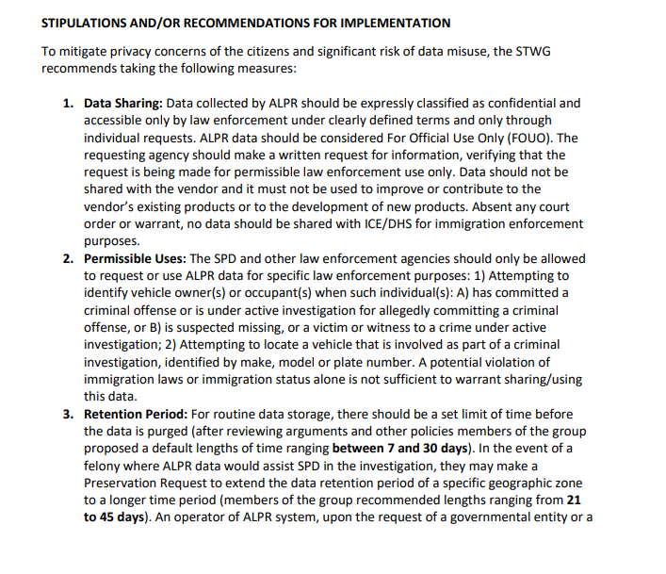
Automated License Plate Readers (ALPR) Discussion
Previous Stipulations that we had drafted can be viewed HERE

Slide 21
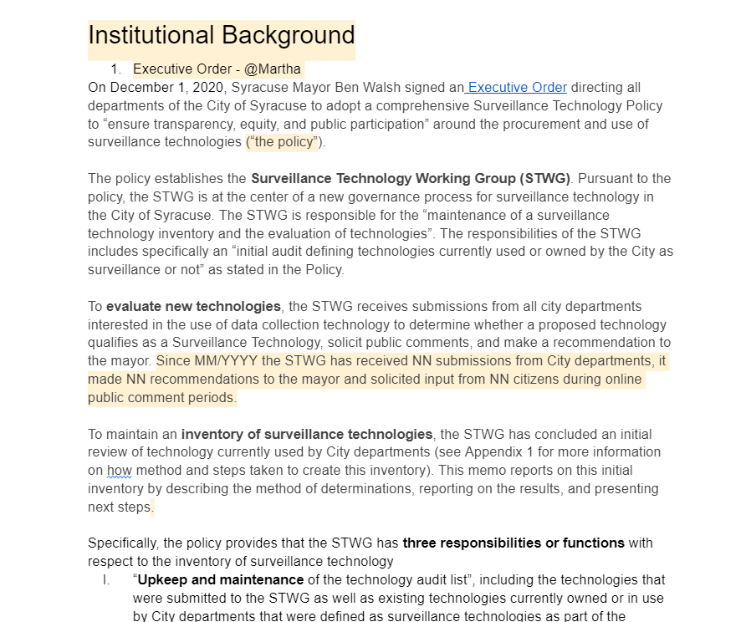
City Wide Technology Audit
The template that we put together so far can be viewed here:
Review updates on different sections

Slide 22
Bus arm and Red Light Camera's
We would like to invite Corey Driscoll-Dunham and Neil Burke to an upcoming STWG to share more about this
Automated speed enforcement in school zones
Speed cameras
Stop arm cameras in school buses
Noise cameras

Slide 23
Coming Up
Meeting with DPW around school zone speed enforcement
ALPR: Final discussion and begin writing recommendation to the Mayor
Audit:
Review sessions with department heads
Provide feedback
Final draft

Slide 24
Questions
?

