Slide 1
Surveillance Technology Working Group
Meeting #33 10/11/2022

Slide 2
Agenda
Technology Audit
Review responses from request for more information
Continue to go through Digital Services form
Coming Up
Questions

Slide 3
Review
Past Decisions
Fotokite: Aerial UAS allowing for different perspectives during crisis response. Not exempt, will go through the process.
Press Release out, done with public comment period
Public comments received, received comments from SPD
Recommendation was sent to the Mayor
Vacant Lot Monitoring: Sensor that detect changes in a scene to monitor lots for dumping. Not exempt, will go through the process.
Press Release out, done with public comment period
Public comments received, waiting for updated data from the requesting department
Community Asset Tracker: Camera with machine learning algorithm to identify objects within the city.
Assessed pilot, documentation provided
COPS: Cameras strategically placed around the city to aid in policing
Exempted

Slide 4
Review
Past Decisions
Samsara: Fleet management technology
Assessed in previous session
Public comment period completed
Recommendation was sent to the Mayor on 2/01
Mayor Walsh stated that he read the read the groups recommendations, and is in agreement with a qualified approval, and is in agreement with the importance of putting in appropriate policies and procedures.
Flock Safety/ALPRs: Street cameras that capture vehicle plates.
Assessed in previous session
Public comment period completed
The Work Group heard from SPD Officers on 1/25/22 for more information regarding this.
The STWG created guidelines for ALPR Use and this was recommended to the mayor with the stipulations written on 3/11/22.

Slide 5
Review
Past Decisions
Cyclomedia: Right of Way Imaging
Public comment period completed
Recommendation was sent to the Mayor on 5/07/22
Mayor Walsh stated: I have reviewed the STWG’s recommendation and I am in agreement with it.
Dataminr: Social Media monitoring of violent posts.
Dataminr staff met with STWG on 6/21/2022.
Dataminr then removed their offer of service on 6/21/2022.
Rubicon: Vehicle route optimization software
STWG met on 9/27/22 and this was determined to not be a form of Surveillance

Slide 6
Review
Internal Norms
Attendance:
If members have unjustified absences for three meetings in a three month time period, the Surveillance Team Working Group (STWG) Coordinators will reach out to the member.
The working group is required to have at least 50% of all members present before we hold a recommendation vote.
Of those present at least 40% should be non-city staff.
External Participants:
Outside participants should request permission before-hand to the API team.
The API team will inform the STWG before meetings if there will be outside participants joining the group.
Documentation for Community Review:
The notes from the STWG Sessions will be posted to the STWG Website after the meetings.
Letter of Commitment:
Is effective for one year, and is to be sent out annually.
View Attendance and Guest Norms

Slide 7
Review
Service Level Agreements (SLAs)
2 - 6 Weeks
(10 - 30
Business Days)
Every 2 Weeks
(10 Business Days)
2 Weeks
(10 Business Days)
2 Weeks
(10 Business Days)
Initial submission to determination of surveillance
Short duration meeting to vote on technology exemptions
Public comment period:
Issuance of press release
Council meeting
(*) For now public input will be received via a Google Form and in the future will be on the new website.
Submission of finalized form (by dept.) to time of recommendation.
Group will individually research; departments will get follow-up questions; group to vote yes/no; and submit recommendation.

Slide 8
STWG Long Term Plan (Review)
Update STWG Website
Tech Recommendations
Meeting Notes and Slide Decks
Connect with other cities doing surv. tech work
Revamp our approach to community engagement
Complete Citywide departmental training
Determine Schedule for refresher trainings (annually or every 6 months)
Complete an audit of technologies currently used by the City as Surveillance or Not
Release an Annual Report
Including recommendations, data that came from recommendations, and if stipulations are being followed.
Short Term
(April - June)
Medium Term
(July - September)
Long term
(October - December)

Slide 9
STWG Long Term Plan (Review)
Begin process of trying to transfer STWG to a City Ordinance
Determine Member’s Term Duration
Requires more planning

Slide 10
Technology Audit Roadmap (Review)
Review List of technology (Make initial determination if “Not Surveillance” or “Need more information”)
For flagged technologies, send Technology Audit Form requesting more info.
When information is received, group votes on whether identified technology will be characterized as surveillance.
Go through same process as Digital Services
In addition, try to schedule a site visit to be able to find more information about how technologies are used.
Go through same process as Digital Services and Fire Dept.
In addition, try to schedule a site visit to be able to find more information about how technologies are used.
Digital Services
Fire Department
Syracuse Police Dept

Slide 11
Definition
Definition of a Surveillance Technology (According to Mayor’s Executive Order on Surveillance Technology):
Technologies that “observe or analyze the movements, behavior, or actions of identifiable individuals in a manner that is reasonably likely to raise concerns about civil liberties, freedom of speech or association, racial equity or social justice.”

Slide 12
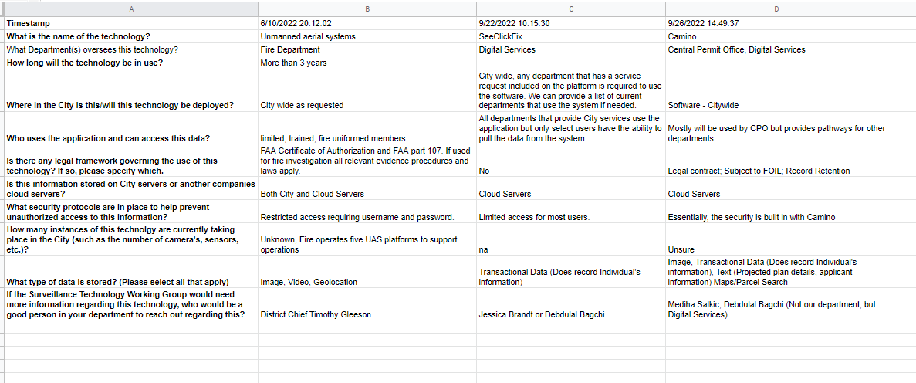
Technology Audit - Software List
Syracuse List of Software (In Progress)
STWG reached out to most of the departments identified and have received responses regarding two of the technologies.
SeeClickFix
Camino
Results from these responses can be viewed HERE

Slide 13
Technology Audit - Software List
Syracuse List of Software (In Progress)
Does the group feel that Creekwalk Emergency Call Boxes fits the definition of a Surveillance Technology? Does the group need more information to make this decision?
Does the group feel that Bit.ly fits the definition of a Surveillance Technology? Does the group need more information to make this decision?

Slide 14
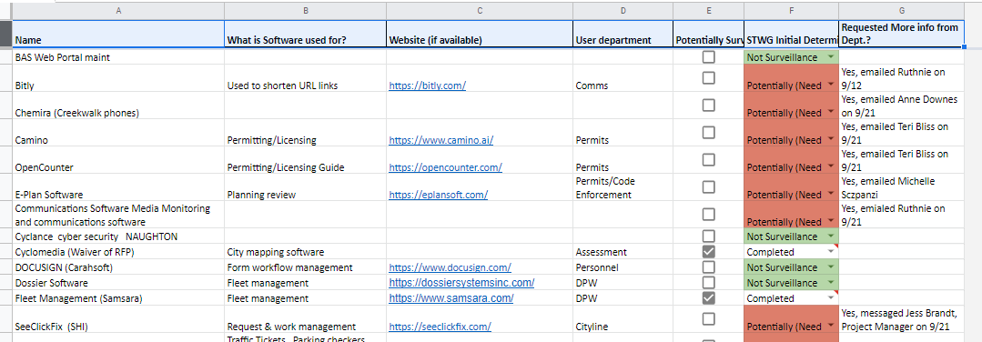
Technology Audit - Software List
Syracuse List of Software (In Progress)
We will continue to go through more of the Digital Services technology list HERE

Slide 15
Technology Audit
Digital Services provided a list of City Software used
List can be viewed HERE
Chief Gleeson provided the list of technology from the Fire Department
He also completed the survey assessment for this technology.
Results can be viewed HERE.
List of technology provided from the Syracuse Police Department are:
Body Cameras
Cops Cameras (these are the street cameras)
Radar Detectors
Speeds Signs
Shotspotter
Temporary Cameras (aka Trail Cams)
Drones

Slide 16
Technology Audit
List of technology provided from Strategic Initiatives/ Internet of Things (Provided by Rebecca)
Vacant lot monitoring – notifications/alerts only. No images relayed, all images processed at the pole and erased. (Already completed)
Road temperature sensing – for ice detection
Street flooding detection
Creek level monitoring
Vacant house smoke and temperature detection
Vacant house motion sensors – notifications/alerts only
Weather/AQ sensors – air temperature, dew point, relative humidity, CO, NO2, O3, PM10, PM2.5
Trash can fullness sensors

Slide 17
Coming Up
For technologies that are being used by the City (Including those identified by Digital Services, Fire Department, and the Police Department)
Will continue to request that the Technology Audit form be completed for identified technologies
Results will be shared with the group
Goal is to determine if the technologies fall within the definition of a Surveillance Technology as identified by the Mayor’s Executive Order on Surveillance Technology

Slide 18
Questions
?

Slide 19
Votes
STWG Member | Vote in Favor | Vote in Favor w/Stipulations | Vote Against | Abstention | Absence
Kelsey May
Sharon Owens
Martha Grabowski
Mark King
Ken Stewart
Chief Tim Gleeson
Johannes Himmelreich
Jen Tifft
1st DC Richard Shoff

Slide 20
Votes
STWG Member | Vote in Favor | Vote in Favor w/Stipulations | Vote Against | Abstention | Absence
Daniel Schwarz
Mujtaba Tirmizey
Michelle Sczpanski
Nico Diaz
Jason Scharf

